Slide 1

HTML WEBSITE PROJECT
Charles Edobor
Ibat college
dublin

Slide 2
CONTENT
INTRODUCTION
AIMS AND OBJECTIVES
PROBLEM STATEMENTS
METHODOLOGY
CONCLUSION

Slide 3
INTRODUCTION
In 1980, physicist Tim Berners-Lee, a contractor at CERN, proposed and prototyped ENQUIRE, a system for CERN researchers to use and share documents. In 1989, Berners-Lee wrote a memo proposing an Internet-based hypertext system.^{[3]} Berners-Lee specified HTML and wrote the browser and server software in late 1990. That year, Berners-Lee and CERN data systems engineer Robert Cailliau collaborated on a joint request for funding, but the project was not formally adopted by CERN. In his personal notes of 1990, Berners-Lee listed "some of the many areas in which hypertext is used"; an encyclopedia is the first entry.

Slide 4
INTRODUCTION
HTML means “ Hyper Text Markup Language it’s a code or group of syntax that can only be understood by a web browser . It also another type of programming language.
CSS means Cascading Style Sheet is what puts finishing touches to a webpage such as colors, font size, background colors etc. Just to add that extra touch to your webpage.
An example is when you build a house you need to paint it to make it look attractive.
For this particular project we had to use visual studio code.

Slide 5
Aims AND OBJECTIVES
The aims and objectives of this project is stated below
To create a wire frame prototype that looks exactly like our webpages.
To create the webpage with navigation bar such as
The home page which is also know as the index page, the about us page which talks about the page with external links , images page shows images with links.
Katalon recorder used to run test cases for the webpage for SRS purposes.
Running an automation on the openweather site that was given.

Slide 6
Problem statement
To run a fully functioning webpage
Use of katalon recorder
To get templates of webpages using draw.io
Navigation panel
Use of css

Slide 7
Methodology
Test Tools
Visual basic studio
HTML code
Katalon recorder
Web browser

Slide 8
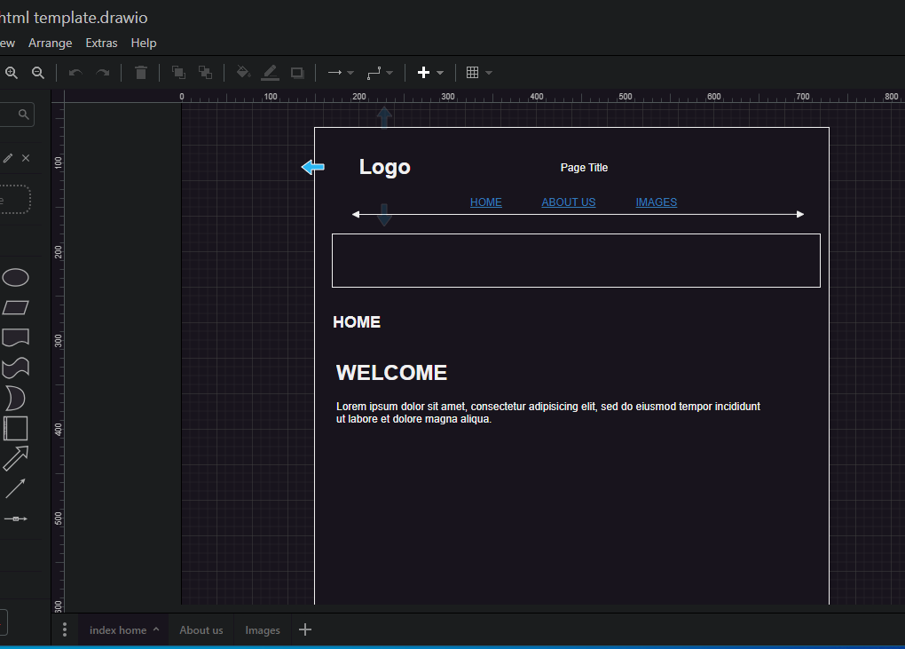
Methodology
Procedures
Creating the wireframe template for the website
Home, about us and the images page were created in the same tab below.

Slide 9
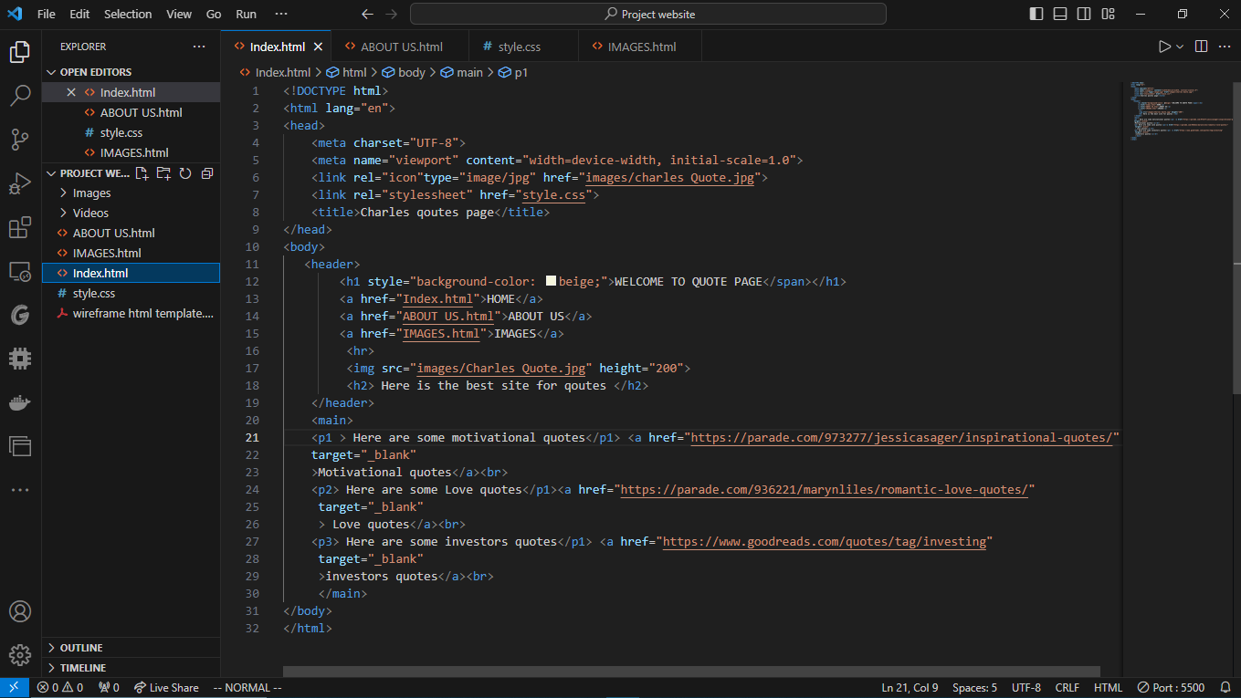
Methodology
Procedures
Using Vs.code to write our HTML code and also the CSS

Slide 10
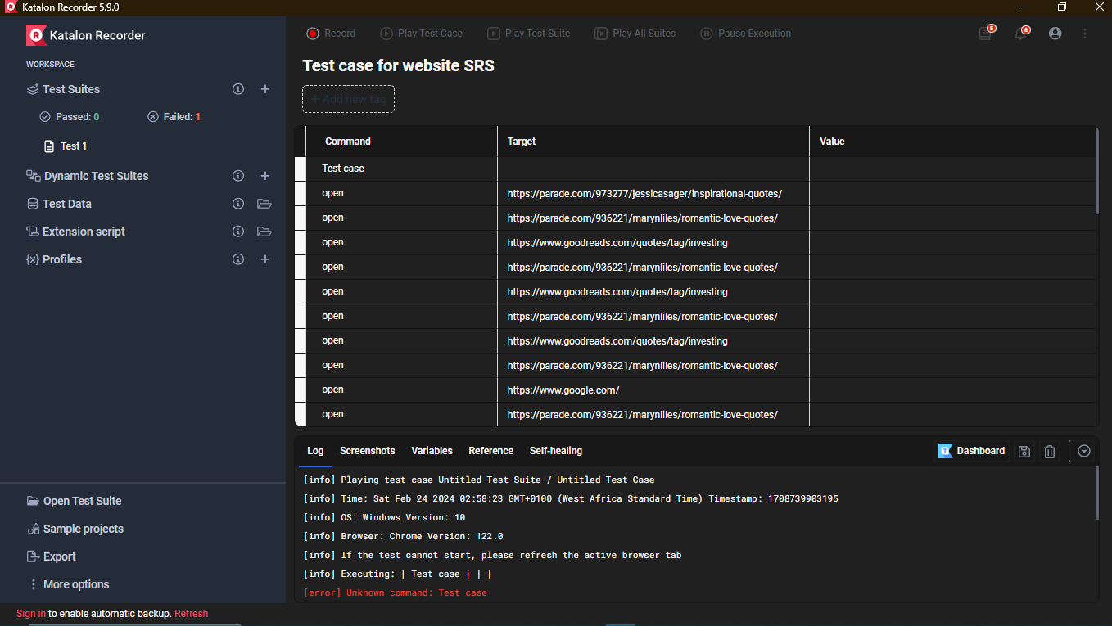
Methodology
Procedures
Using the katalon recorder to run test cases and also automation for the openweather site for the website for SRS (software requirement specification).

Slide 11
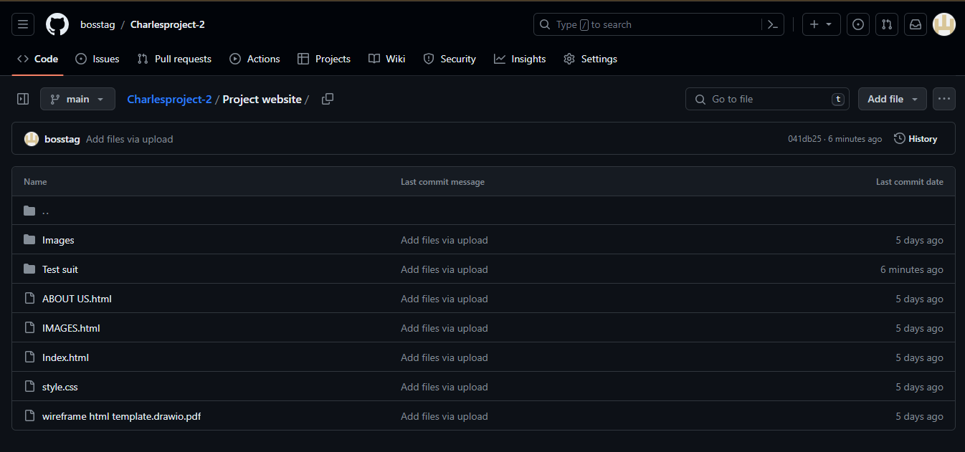
Methodology
Procedures
Link for my project website on Github
https://github.com/bosstag/Charlesproject-2.git

Slide 12
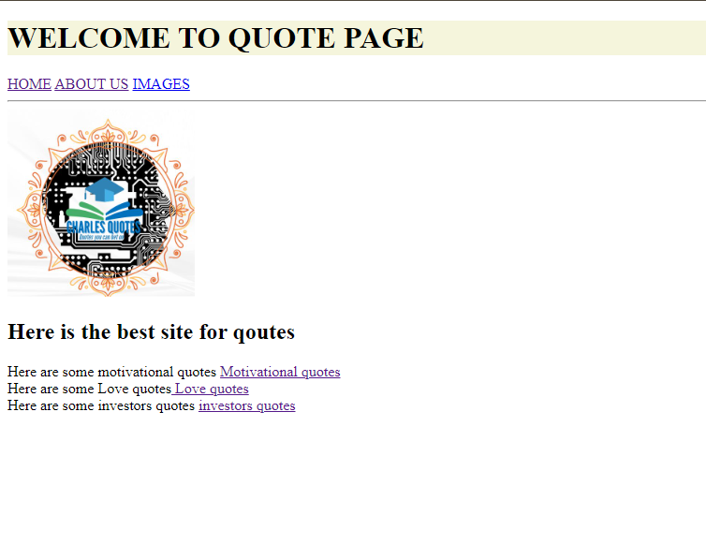
results
RESULTS
Testing of codes from the html code and viewing it on a web browser showing the home page.

Slide 13
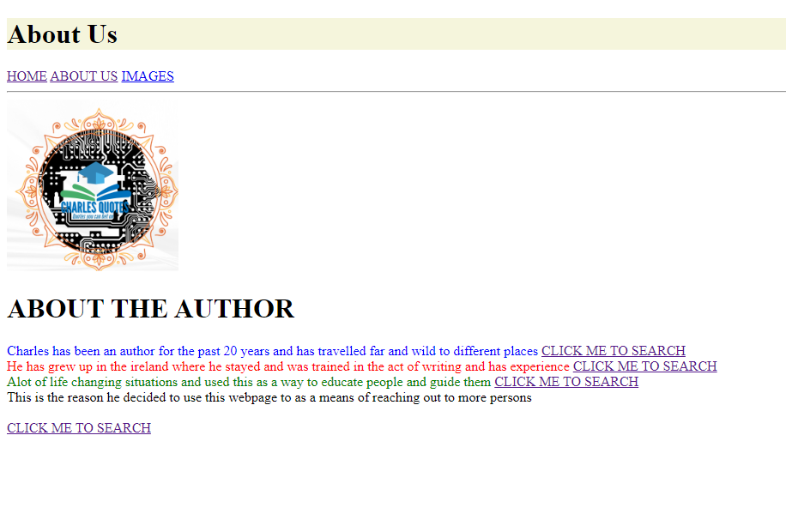
results
RESULTS
Testing of codes from the html code and viewing it on a web browser showing the about us page.

Slide 14
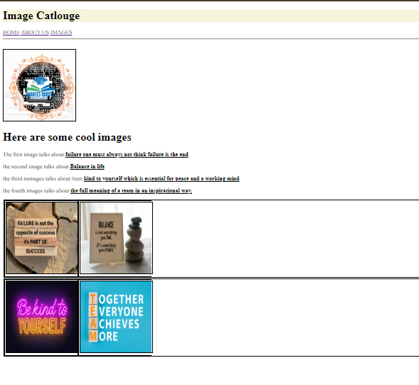
results
RESULTS
Testing of codes from the html code and viewing it on a web browser. Images page

Slide 15
CONCLUSION
The following conclusion were observed
Objectives were achieved such as creating a wireframe for the design of our webpage.
Creating each page and using external links.
Changing test size and making it bold with an emphasis on underlining the text.
Using katalon recorder to carry out test cases.
Running an automation of the weather page for 10 countries.

Slide 16
Thank you
For
Listening

